Slide 1

Comparison of Region Based on Sales

Slide 2

Objectives
Help the organization by creating a dashboard to visualize the sales comparison between two selected regions.

Slide 3

Problem Statement
The director of a leading organization wants to compare the sales between two regions. He has asked each region operators to record the sales data to compare by region. The upper management wants to visualize the sales data using a dashboard to understand the performance between them and suggest the necessary improvements.

Slide 4
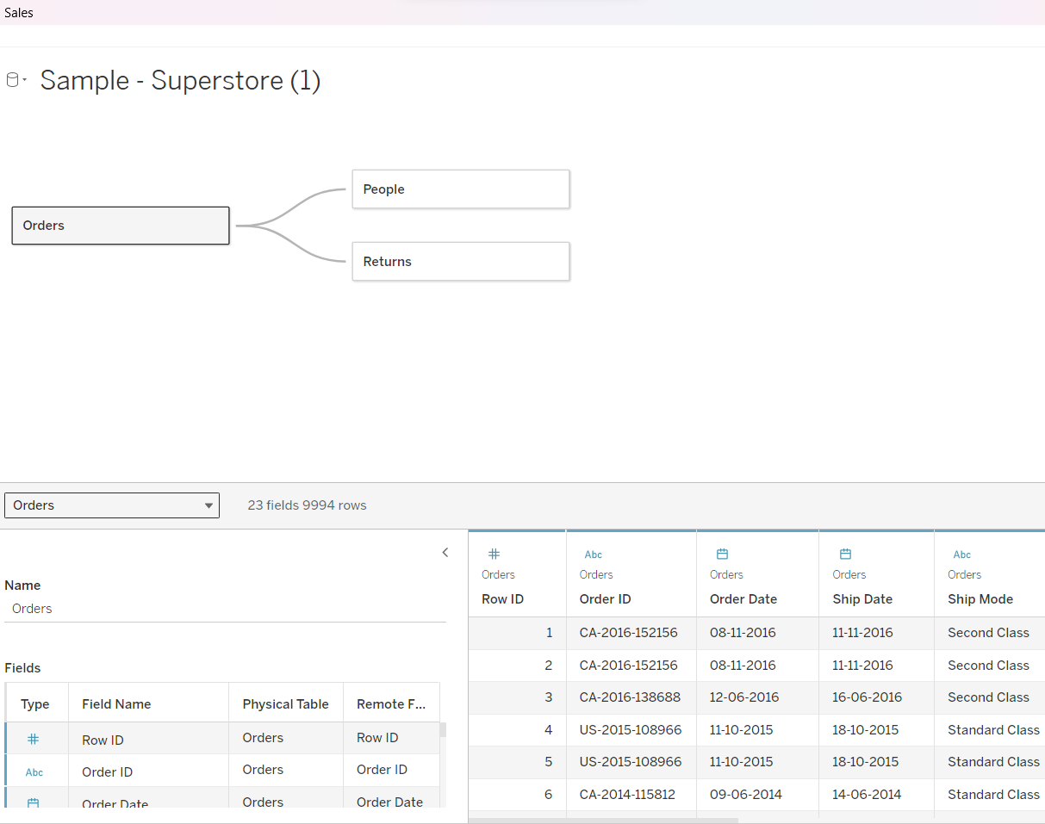
Select Sample Superstore as Dataset
Use Sample Superstore Dataset
Select Data

Slide 5
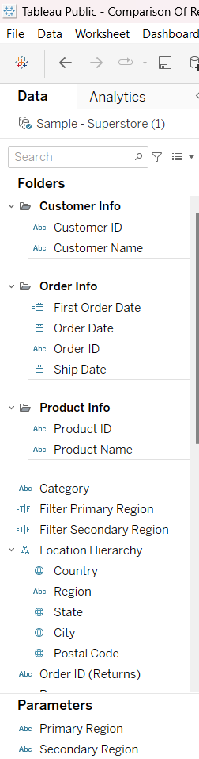
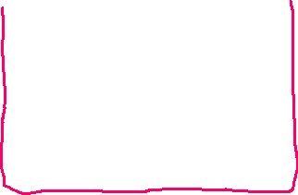
Use Group by from Data Source Table on a Folder to create a folder to segregate the required data for Customer Name and Order ID in order to organize the data thoroughly.

Slide 6
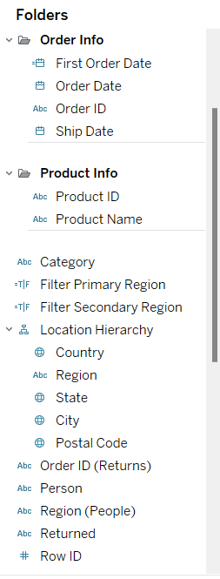
Create a hierarchy called Location for the variable Country.

Slide 7
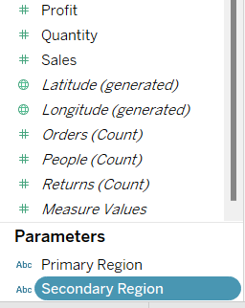
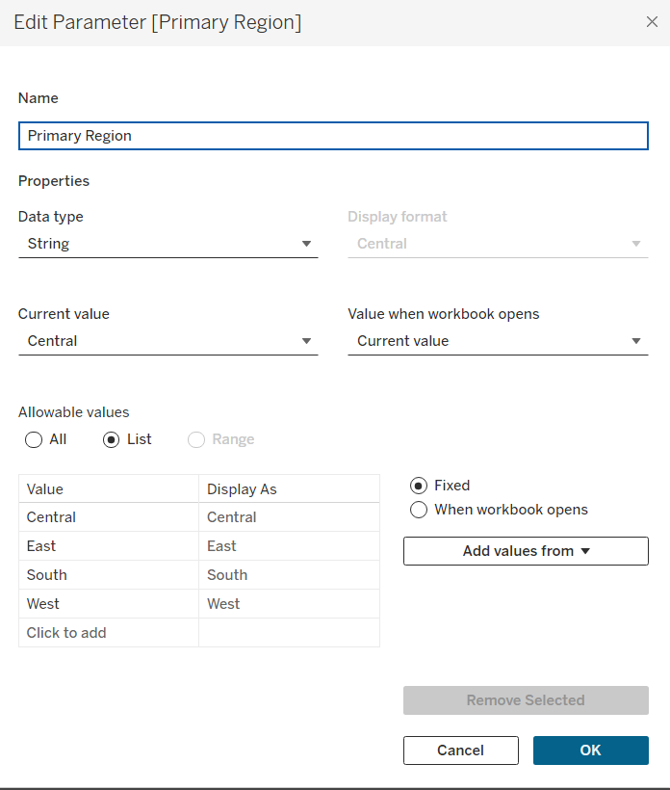
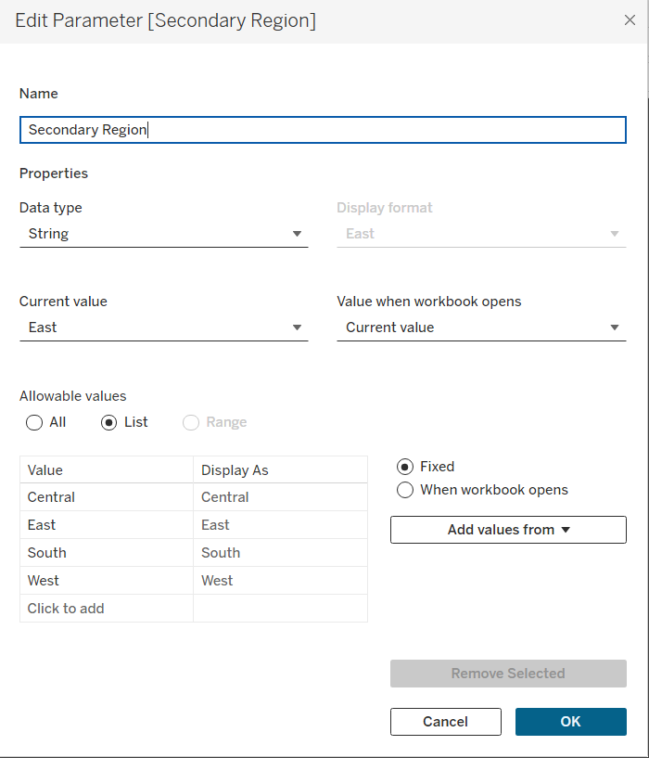
Create two parameters: Primary Region and Secondary Region with all regions listed in them. Here, primary and secondary region are the two regions where the sales are being compared.

Slide 8
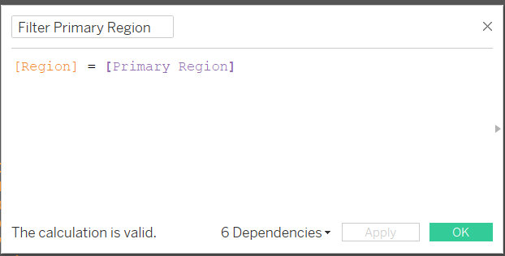
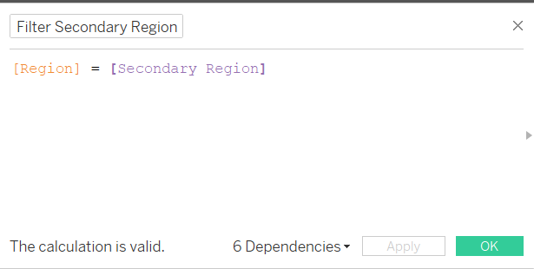
Create a Calculated Field for both Primary Region and Secondary Region

Slide 9
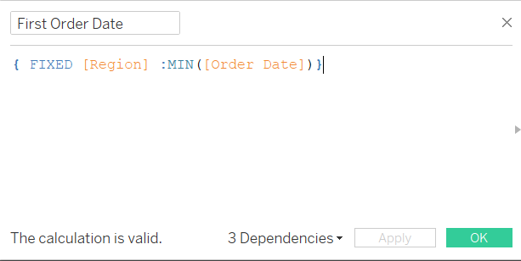
Create a First Order Date
Create a Calculated Field and name it as the First Order Date

Slide 10
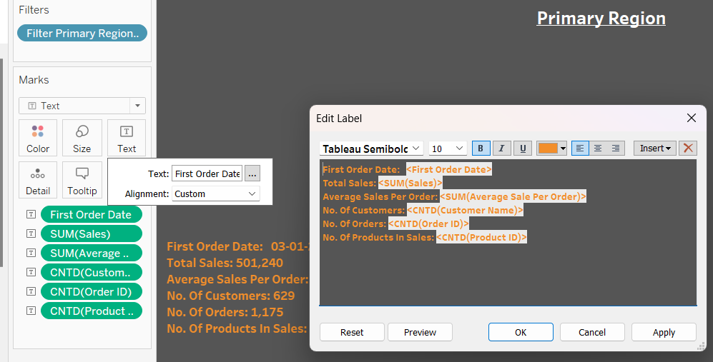
Displaying the following details for the Primary Region:

Slide 11
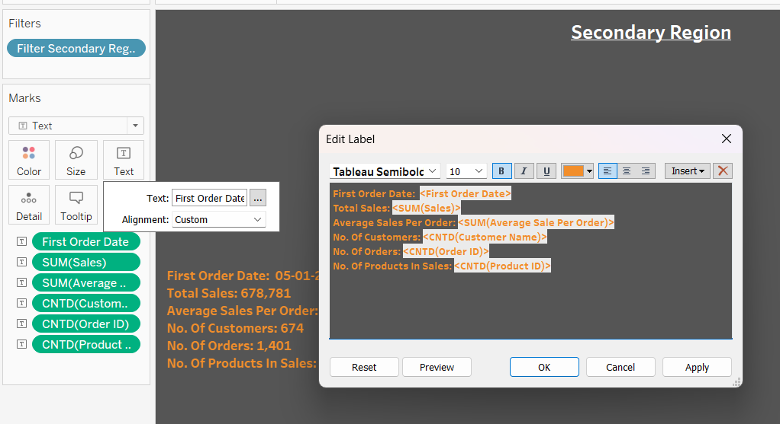
Displaying the following details for the Secondary Region:

Slide 12
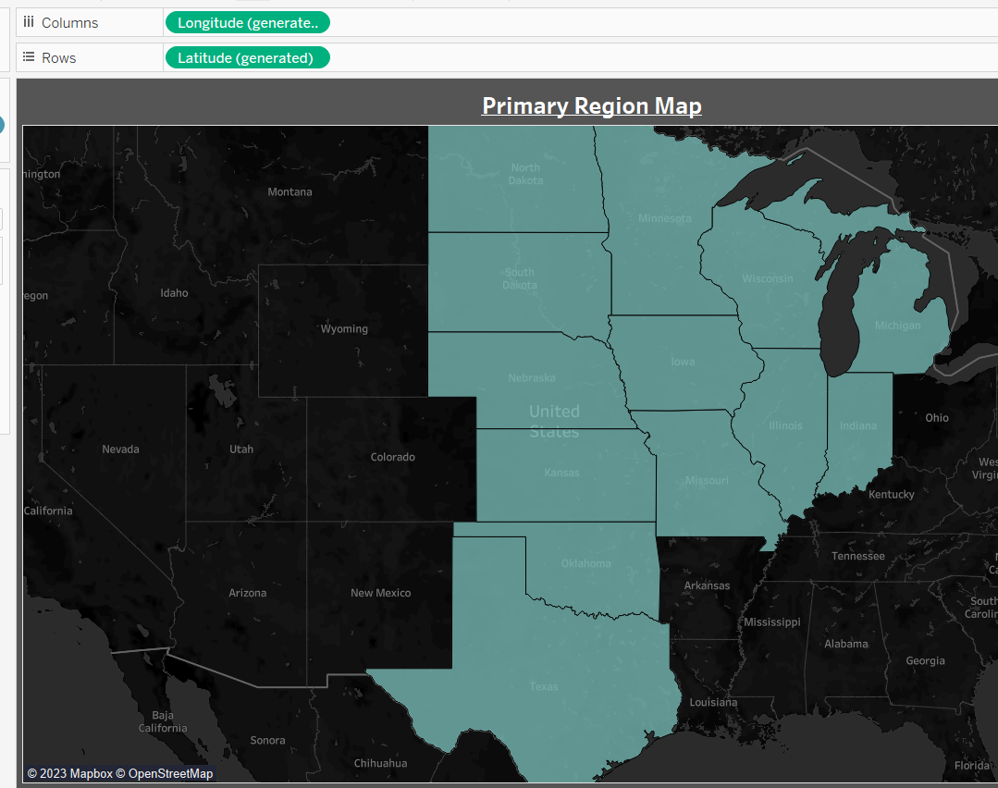
Primary Region Map

Slide 13
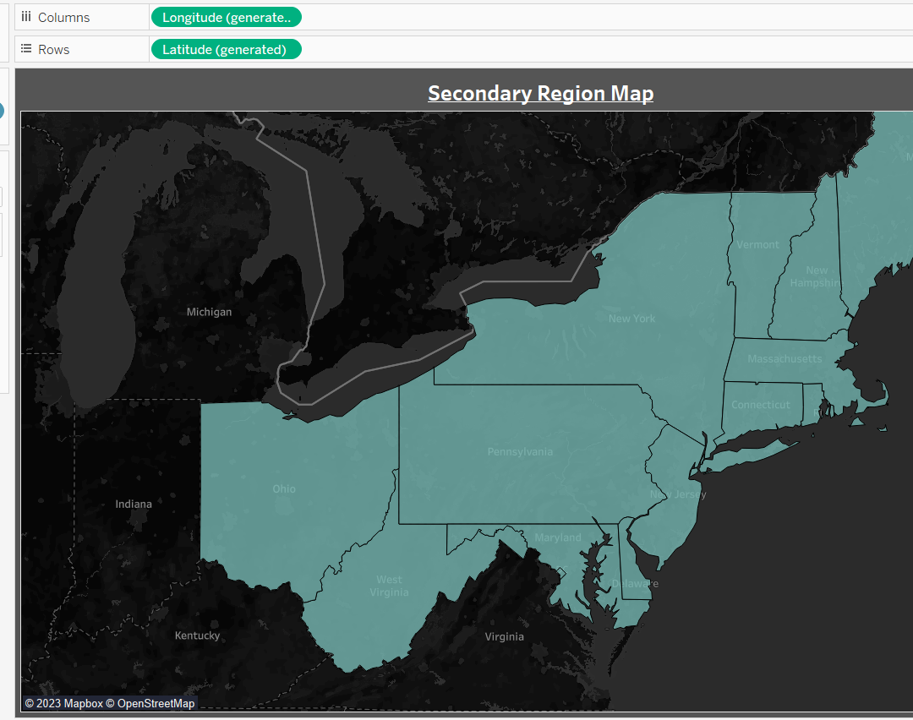
Secondary Region Map

Slide 14
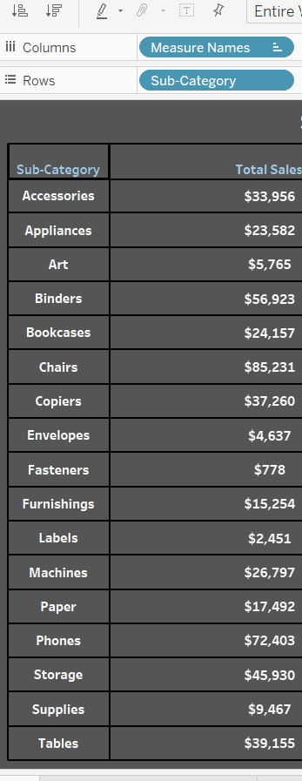
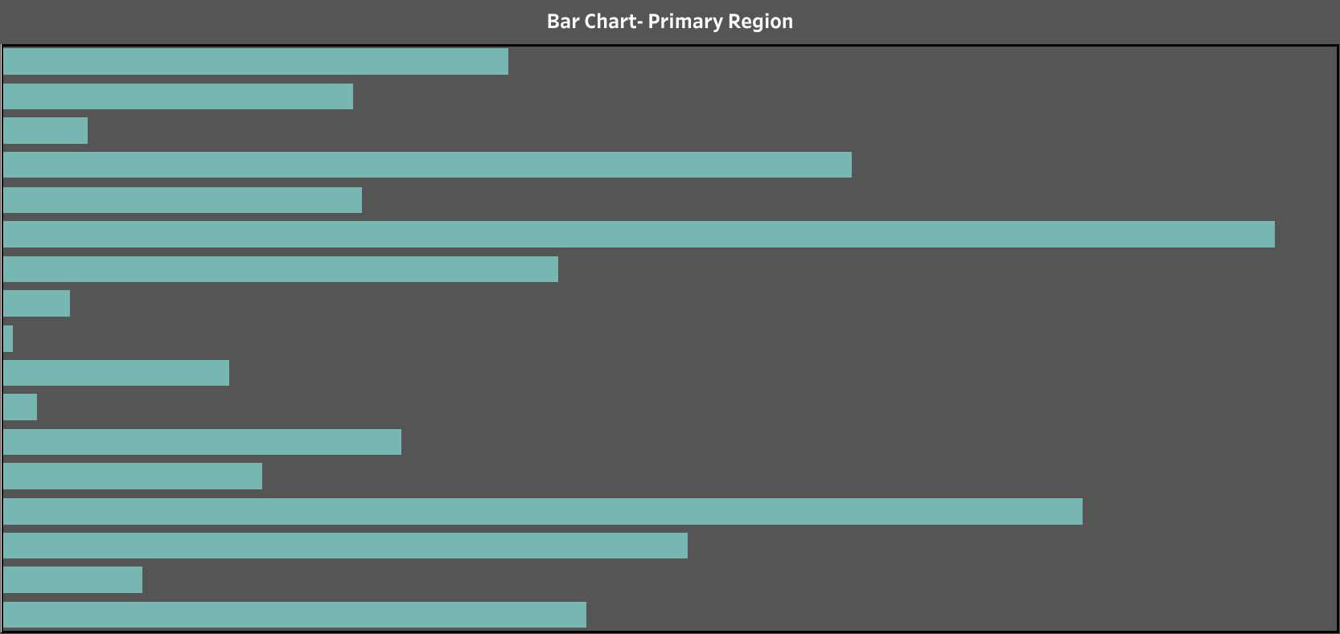
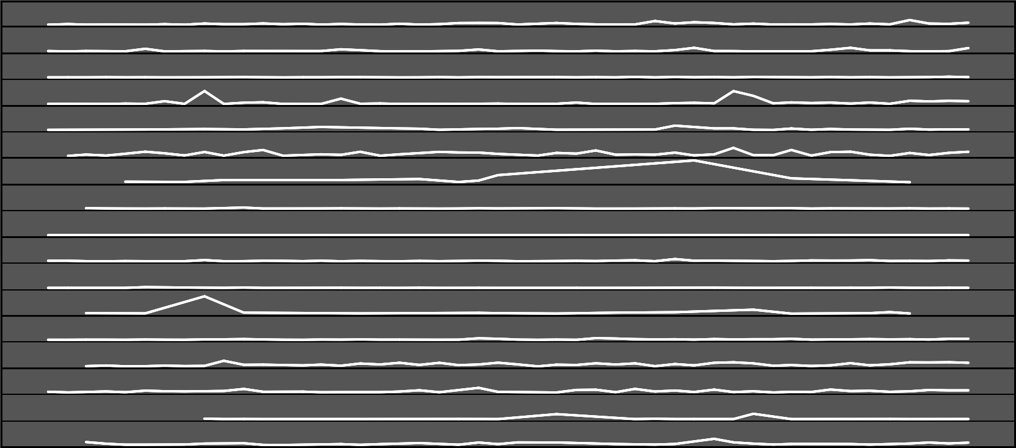
Primary Region Details

Slide 15
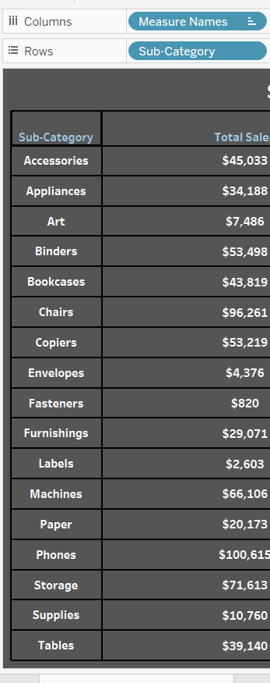
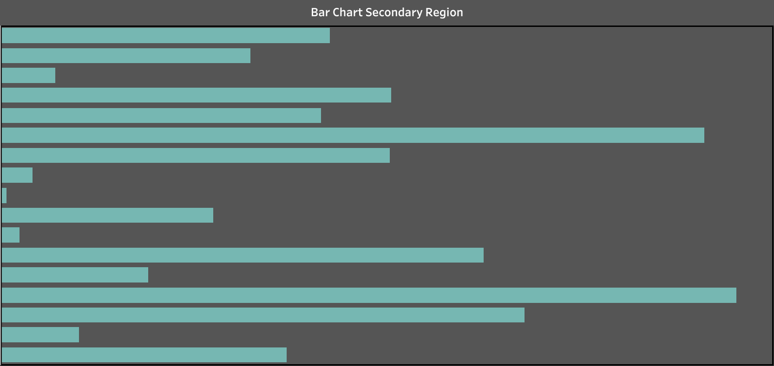
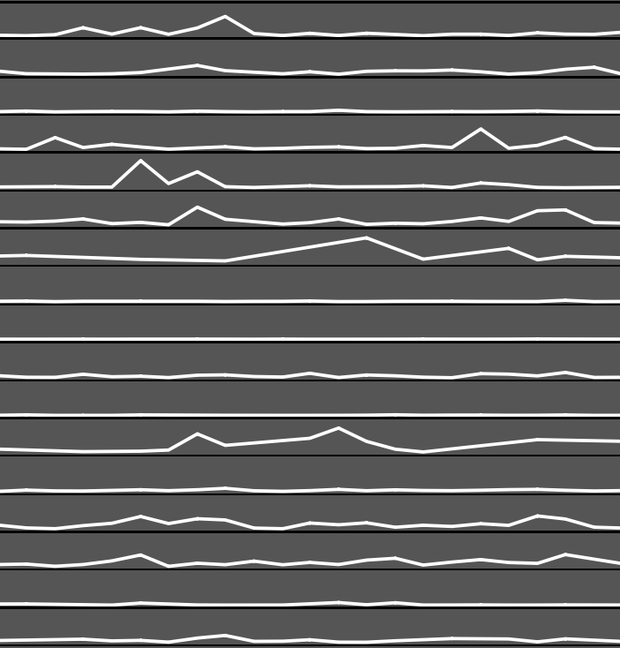
Secondary Region Details

Slide 16
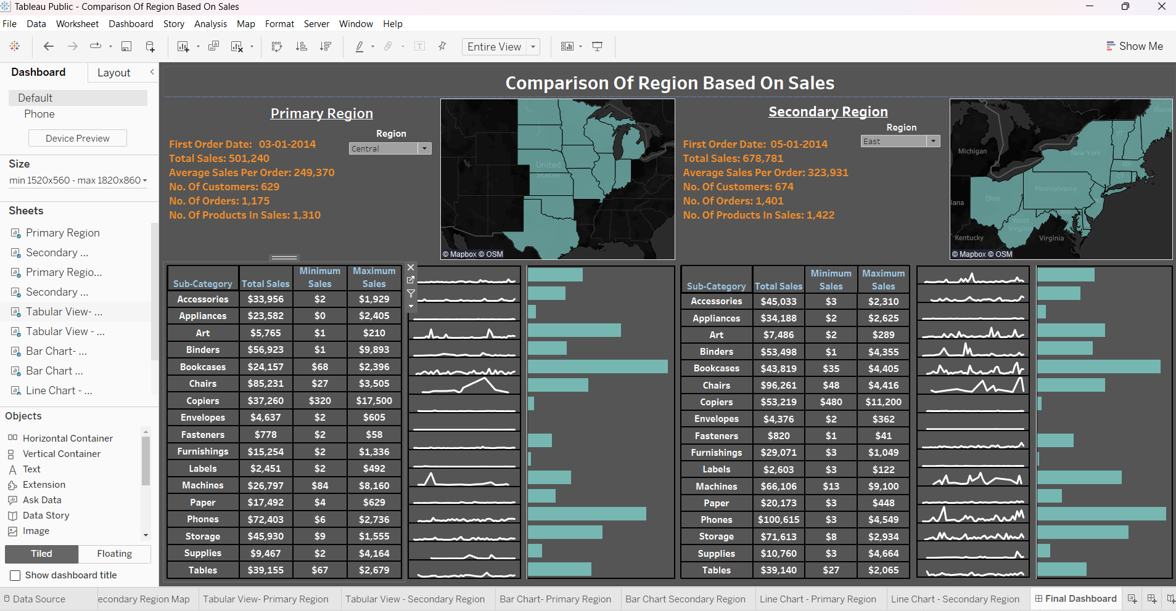
Sales Comparison by Primary and Secondary Region

Slide 17
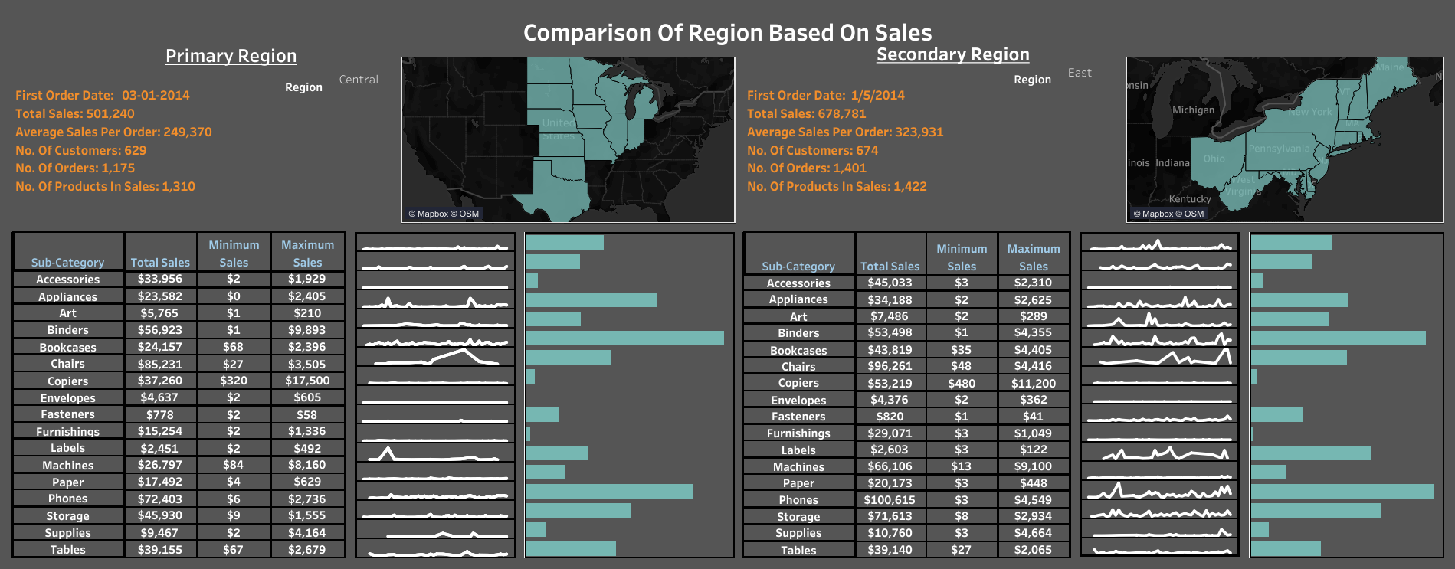
Final Dashboard
Dashboard Link: https://public.tableau.com/shared/BKRZGZ6G3?:display_count=n&:origin=viz_share_link

Slide 18

Project Outcome
This project aims to develop a dashboard that visualizes sales comparisons between two selected regions.
By utilizing these dashboards, the organization can proactively implement measures to enhance sales in these regions.I order to increase sales, the organization can take preventive measures using dashboards.

Slide 19
Thank You

